Slide 1
Swiggy Application
Online food order application.

Slide 2
Synopsis
The main objective of the Project on Online Food Ordering System is to manage the details of Food, Item Category, Shopping Cart, Customer, Order.
It manages all the information about Food, Delivery Address, Order, Food.
This sites consists a various types of foods.
It allows users to make payment through various modes like upi and using card.

Slide 3
Features
Register and login via email
user can update/delete his/her profile
user is able to place food
payment method
Admin can add/update/delete food.
Admin can add/update/delete restaurants.

Slide 4
User Stories
implement Login and Signup Api :- user can login via email
implement jwt :- for authorization purpose
implement swagger
implement MongoDb
payment api:- implement payment integration for online payment
food & restaurants api :- Add/Get/Update/Delete
User api :- registration/login/update/delete profile

Slide 5
Software Requirements
Spring Tool Suite
MongoDbCompass
Postman
Git
Junit
Mockito

Slide 6
Hardware Requirements
Processor: - 1.2GHz and above
Hard Disk: - more than 20GB
RAM: - Minimum 1 GB

Slide 7
Model Class
User
Food
Restaurants
Cart
Orders
Payment

Slide 8
Services
Registration and Login service
Food Service
Restaurant Service
Cart Service
Order Service
Payment Service
Api Gateway

Slide 9
Registration and Login Service
User can register via email, name, password and mobileNo.
User can login via email and password
Implemented jwt and role based authentication.
After login jwt token will generate.
Using that jwt token user can access other services without login again.
Login api
Registration api

Slide 10
Food Service
User can see the food items after login.
Admin can add, update, and delete food.
Add food
Get food
Update food
Delete food

Slide 11
Cart Service
User can select the food from food items list.
Selected food item will go in to the cart.
We can get the user details and food details by cart id. Like which user added which food in cart.
Add items in cart
Get cart items
Delete cart items
Update cart items
Get cart by user id

Slide 12
Order Service
We can store the order details in database like what is the payment status ? How much amount paid by user and how much is pending ?
Here I used razorpay payment api, so whenever user click on add to cart button razorpay generate a order id for us. We have to store the order details in database.

Slide 13
Payment Service
After adding to cart, user click on pay button and then we need to send the order id to the razorpay server. Razorpay server verify the payment and generate a payment data based on order id, which contains payment id, razorpay signature, payment status and many more.
Payment api

Slide 14
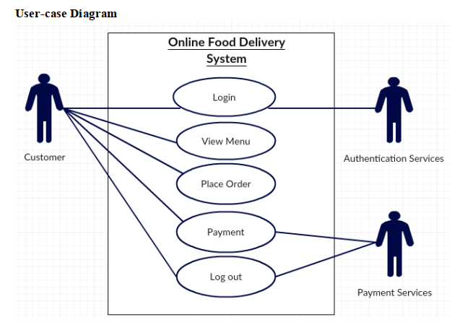
Use Case Diagram

Slide 15
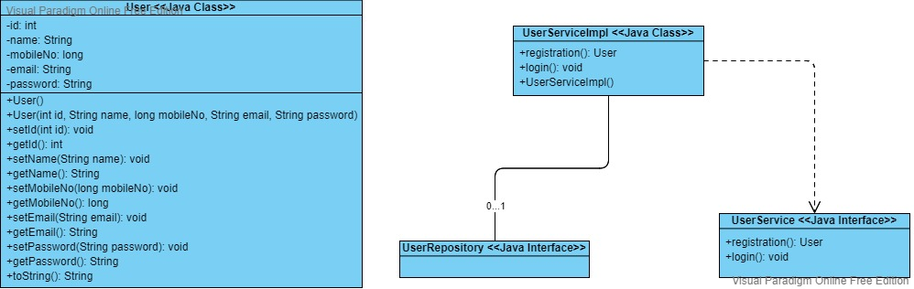
Class Diagram for User

Slide 16
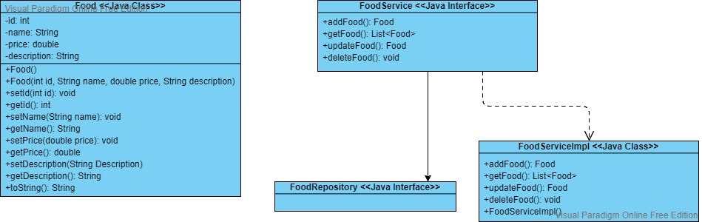
Class Diagram for Food

Slide 17
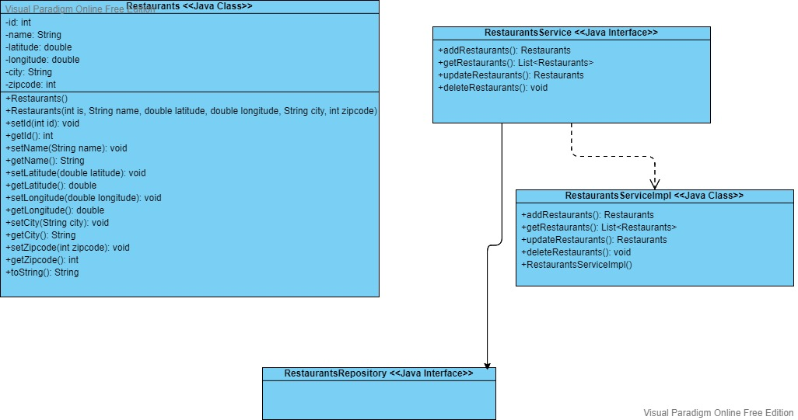
Class Diagram for Restaurants

